Slide 1
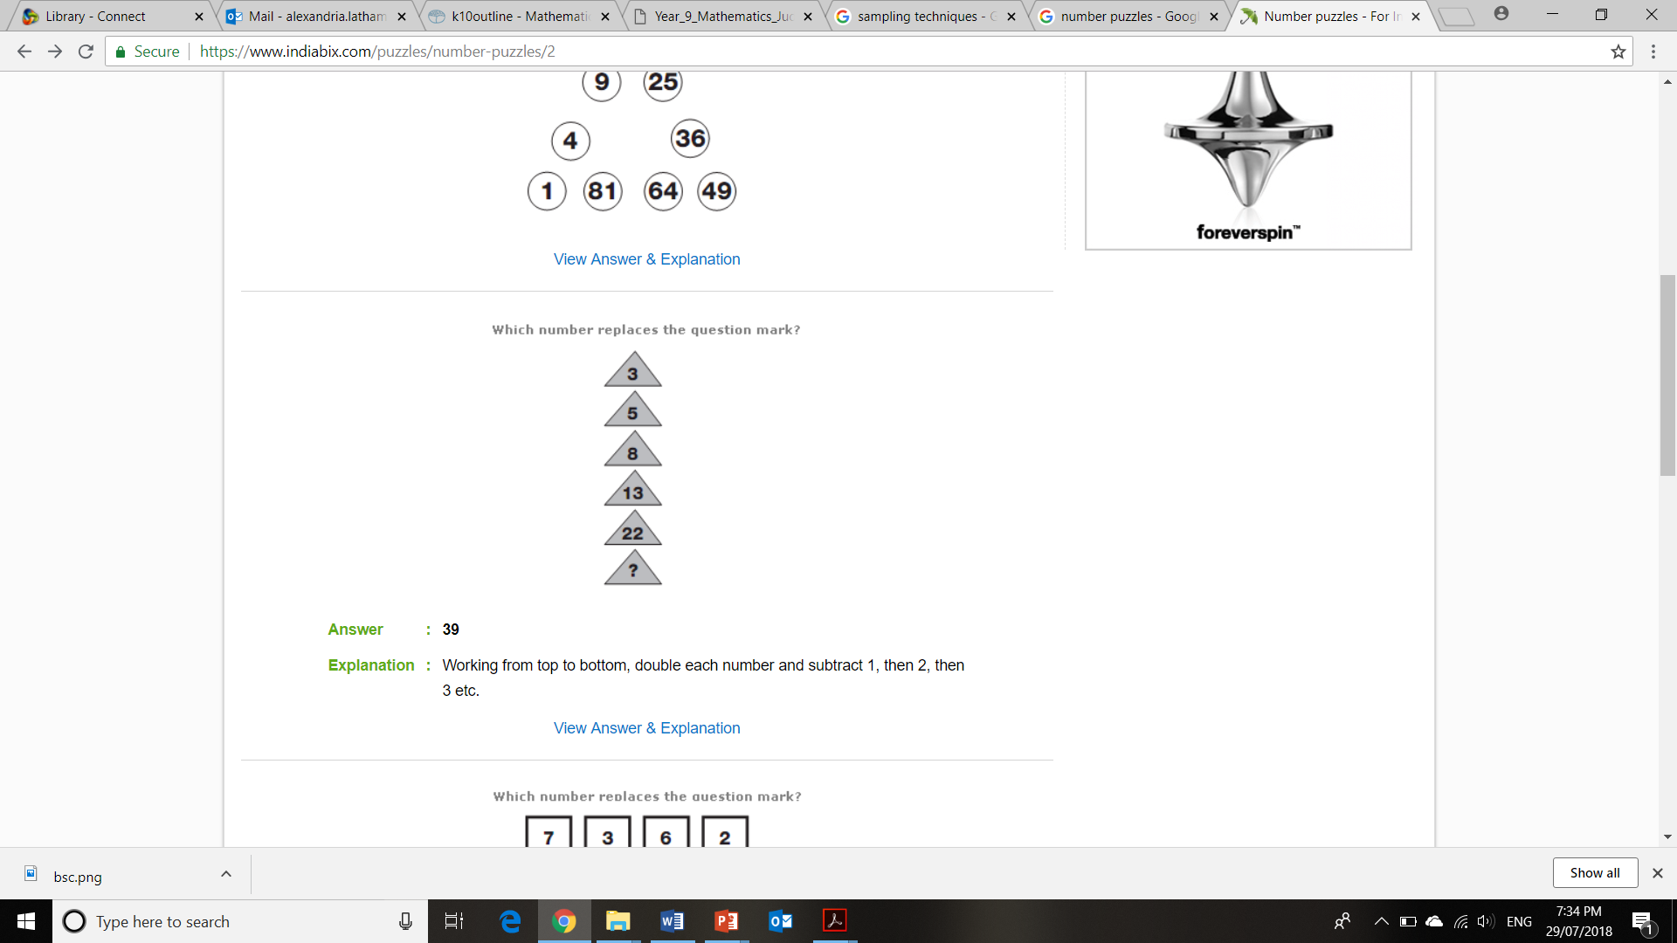
Topic: Collecting Data
EQ: What do we need to consider when collecting data?
Ms. Latham

Slide 2
Add a Slide Title - 1

Slide 3
Topic: Collecting Data
EQ: What do we need to consider when collecting data?
Think – Pair – Share
What would you do if you wanted to know if left handed or right handed people were taller? How could you collect that data?
What is a census?
A collection of data from the whole population
+ accurate
+ reflects everyone's opinion
- Takes a lot of time
- Could be expensive
Can you think of any advantages/ disadvantages for each of these?
What is a sample?
A collection of data from the part of the population
+ can be done quickly
+ not using as much resources
- Tricky to get good sample
- The smaller the sample the larger the error
Fun Fact! The 2011 Australian census cost $440 million dollars

Slide 4
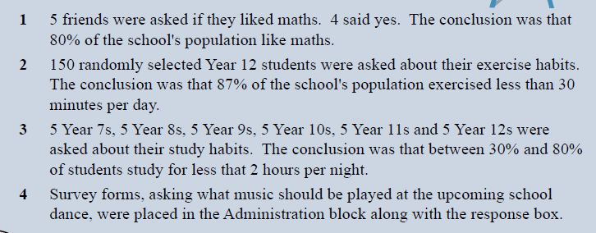
What is wrong with each of the following questions? How could you improve these??

